Slide 1
Welcome to
Budgeting for Financial Success
Presented by Barbara Agin

Slide 2
Agenda
What is a budget?
Benefits of creating a budget
Where to begin
Creating and maintaining a plan
Tools to help manage and analyze spending
Sample Budget Worksheet
Adapting to a changing financial environment
Budgeting for holiday spending and the unexpected
Tips and resources
Questions

Slide 3
What is a budget?
A measurement of your income and expenses for a certain period of time
A month
A quarter
A year

Slide 4
Benefits of creating a budget
Allows you to save for future goals
Prevents you from overspending
Puts a spotlight on bad behavior
Alleviates stress (because you have a plan)!

Slide 5
Additional Benefits
Breaks the paycheck-to-paycheck cycle
Help you get out of debt
End fights about money (with parents/partner)

Slide 6
Wants versus Needs
Items
Wants
Needs
Housing including utilities
Food
Transportation
Insurance
Eating out
Designer clothing
Travel

Slide 7
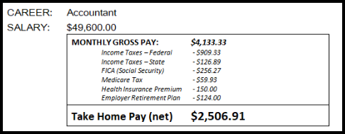
Where To Begin?
Calculate your monthly income after taxes
If you are not salary, use the lowest possible monthly income figure
Consult a Tax Advisor to be sure you have sufficient deductions

Slide 8
Where To Begin?
Identify fixed and variable deductions
Fixed Expenses include:
Rent/Mortgage
Car Payment/Public Transportation
Auto Insurance
Student Loans
Cable/Internet

Slide 9
Where To Begin?
Variable Expenses include:
Groceries
Dining Out
Gas
Clothing
Utilities

Slide 10
Don’t forget about
Christmas, Hanukkah and other holiday spending
Birthdays
Annual Vacations

Slide 11
Identify Outstanding Debt
Student Loans
Credit Card Debt
Personal Loans

Slide 12
Prepare a Budget Worksheet

Slide 13
Analyze Results
If you are spending more than you earn, decide what to cut back on
If you have money left over
Look at a structure to pay down debt
Select an automatic amount to go into savings
Start thinking about retirement

Slide 14
Budgeting Tips
First time through is your estimate
Track your actual expenses for a month and record
Fixed, Variable, Other
Tools for tracking expenses
Check register (old school)
Use an app
Create a spreadsheet

Slide 15
Budget Goals – Short and Long Term

Slide 16
Tools to help you Manage and Analyze Spending
Bill Pay Functions
Budgeting Apps

Slide 17
Adapting to a Changing Financial Environment

Slide 18
Holiday Spending and the unexpected
Tis the Season …
And then along came ….
LIFE
HAPPENS

Slide 19
Additional Resources
https://consumer.gov/managing-your-money/making-budget
www.dummies.com/personal-finance/budgeting/how-to-track-your-expenses/

Slide 20
Questions?
Thank you for attending

